Slide 1
FINANCIAL AID & AWARDS
Ontario Student Assistance Program
Ontario.ca/osap
2021.22
Notes:
Recruitment to open presentation & introduce FinAid partner.
Poll Question: What are you hoping to learn about today? (Multiple Choice)

Slide 2
LET’S GET STARTED
Education is an investment in yourself.
Careful PLANNING, BUDGETING, SAVING, and your Financial Aid Office, all play an important role in paying for your education.
Notes:
FinAid to deliver this side.

Slide 3
POST-SECONDARY COSTS
Notes:
FinAid to deliver this side.

Slide 4
PLANNING & BUDGETING
1
What are your Costs/Expenses
Sample expenses for an academic year (8 months).
Expense Amount Type
Tuition & Fees
Books and Supplies
Rent (off campus, inclusive)
Transportation
Cable (television)
Internet
Cellphone
Food and household supplies
Laundry (laundromat)
Pocket money (entertainment, etc.)
Total
Fixed
Variable
Fixed
Variable
Variable
Variable
Variable
Variable
Variable
Variable
$4000 -$6500
$1000
$6400
$800
$500
$400
$500
$3300
$400
$1600
$18,900 – $21,400
Notes:
FinAid to deliver this side.
Link: https://www.niagaracollege.ca/fees-finances/prepare-an-expense-budget/
What are your costs going to be?

Slide 5
2
Create your budget.
Include ALL your educational & living costs and all of your resources
Use on online budgeting tool like MINT.COM
3
Review your expenses.
How can you reduce your costs?
2 medium coffees/day for 8 months = $785 OR Buying lunch (cafeteria) for 1 week = $50
4
Savings!
Work and save money when possible. Put a little aside for the unexpected.
Consider volunteering to boost scholarship applications.
.
5
Tips to stay on track:
Review your bank account transactions regularly.
Pay your-self first; create a safety net.
Look for discounts/sales and use your student ID card.
Notes:
FinAid to deliver this side.
Notes for #4;
Cell phone plan, internet/cable bundle
Avoid high interest credit cards, bank machine fees, and late fees
Make meals instead of ordering out or using food delivery
Take the bus, ride a bike, or carpool
Use computers, internet & gym at school once available

Slide 6
ONTARIO STUDENT ASSISTANCE PROGRAM
Ontario.ca/osap
Notes:
FinAid to deliver this side.
Poll Question: Will you be applying to OSAP? (Single Choice)

Slide 7
OSAP
www.ontario.ca/osap
Grants (you keep)
Loans (you pay back)
When you apply, you will automatically be considered for grants (non-payable) and loans (repayable).
Did you know that you can decline the loan portion by requesting Grant Funding
Only
Notes:
FinAid to deliver this side.

Slide 8
HOW IS CALCULATED
EDUCATION COSTS
-
FINANCIAL RESOURCES
=
FINANCIAL NEED
Educational Costs: tuition, compulsory fees, books, supplies and equipment
Living Expenses: housing, utilities, food, transportation, entertainment
Student Income: employment & government income received during the school year
Parental previous year income
Scholarships & Bursaries
Assets
The amount of funding available to you through OSAP loans & grants
Notes:
FinAid to deliver this side.
Source: https://www.ontario.ca/page/osap-definitions

Slide 9
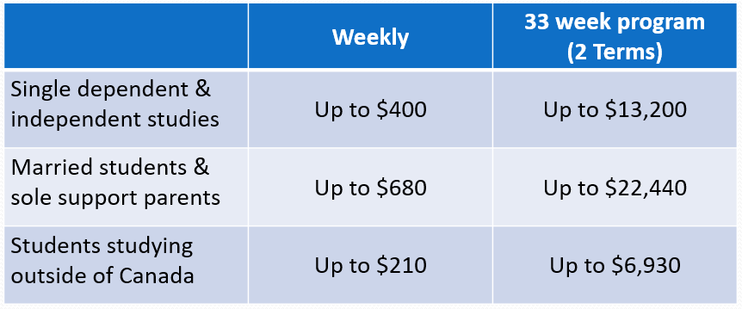
HOW MUCH CAN I RECEIVE?
Notes:
FinAid to deliver this side. Poll Question (before switching to the next slide): True or False: OSAP gives away free money. (Single Choice)
Link: https://osap.gov.on.ca/AidEstimator2021Web/enterapp/enter.xhtml

Slide 10
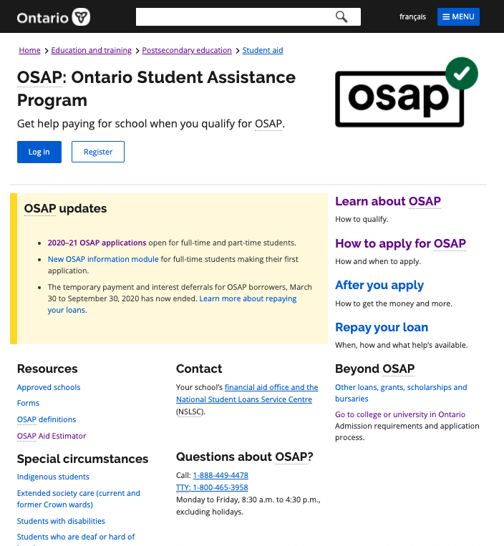
WHEN & HOW TO APPLY
The OSAP application for the 2021/22 academic year is OPEN!
You are able to LOGIN and start your application.
If you have not done so already, you can click on REGISTER and start creating your OSAP account
APPLY EARLY! Supporting documents can take up to 4 weeks to process.
Notes:
FinAid to deliver this side.
Link to Provide: https://www.niagaracollege.ca/fees-finances/financial-aid/osap/step-by-step-guide/
Poll Question (before switching to the next slide): True or False: OSAP provides you with loan repayment assistance after you graduate. (Single Choice)

Slide 11
APPLICATION STEPS
SUBMIT A NEW APP.
Assessments avail. In June
PRINT/UPLOAD
the required
documents
COMPLETE your MSFAA online
Pay your
TUITION
DEPOSIT, June 2021
Step 1
Step 2
Step 3
Step 4
Track the
STATUS,
View Funding
Summary
School Confirms Enrolment &
FUNDING
is RELEASED
Select
your
TIMETABLE
CHECK your
OSAP Message
Centre
Step 5
Step 6
Step 7
Step 8

Slide 12
WHAT INFORMATION WILL OSAP REQUIRE FROM ME?
School, program name & year
Parent(s) SIN, First/Last Name
Parent(s) marital status
Parent(s) 2020 Income Tax Return
Minimal income information from student
Consent to release information

Slide 13
OSAP UPDATES 2021-2022
Federal Grant amounts will continue to be doubled for 2 additional years
Interest waived on Federal Loans until March 31, 2023
Supporting Indigenous postsecondary education

Slide 14
OSAP APPEALS
Local Travel
Living Allowance
Exceptional Expenses
Change to parental income
Visit your school’s website
niagaracollege.ca

Slide 15
REPAYMENT
Repayment on your loans begins 6 months from your last full-time study period end date.
INTEREST
Federal 6 months
Provincial begins immediately
Having difficulty repaying your loans? You may be eligible to have your interest and payments temporarily waived.
RAP
Repayment Assistance Program
Repayment Calculator:
https://osap.gov.on.ca/AidEstimator2021Web/enterapp/debt_calculator.xhtml
Notes:
Financial Aid to deliver this slide.
Link to Provide: https://www.canada.ca/en/services/benefits/education/student-aid/grants-loans/repay/assistance/rap.html

Slide 16
SCHOLARSHIPS, BURSARIES, & OTHER SUPPORTS
Notes:
FinAid to deliver this side.

Slide 17
SCHOLARSHIPS & BURSARIES
Check the Financial Aid website at the institution you are attending.
Award amounts and criteria can vary: academic excellence, financial need, leadership, volunteer and/or community involvement
Check your high school/District School Board website, your bank, parent/spouse’s employer, your own employer, and community organizations that you or a family member belongs to.
External awards are available through many businesses and organizations!
Check out these websites as well:
www.studentawards.com
www.scholarshipscanada.com
www.scholartree.ca
Notes:
FinAid to deliver this side.
Links to websites in slide.

Slide 18
STUDENT JOBS ON CAMPUS
53% of students report that they must work while going to school to make ends meet.
Every college & university has on-campus jobs for students to ‘earn-while-they-learn’.
Notes:
Recruitment to speak about student jobs on campus. Reference NC Expert job to bridge from previous slide.
Links: https://mycareer.niagaracollege.ca/home.htm & https://www.niagaracollege.ca/studentlife/eac/

Slide 19
STUDENT LINE OF CREDIT
Bank Loans
Lines of Credit
A student line of credit allows you to borrow what you need, when you need it, to cover your student costs. Speak to your bank for further information!
Notes:
Speaking Notes
A student line of credit gives you a set amount of funds that you can borrow as needed and you’re only charged interest on what you borrow.
For example, if you have a $15,000 line of credit and only borrow $5,000, you are only charged interest on the $5,000.
Speak to your bank about an appointment with a Financial Advisor.
Link to Provide: https://www.niagaracollege.ca/fees-finances/financial-aid/loans-and-lines-of-credit/

Slide 20
WE’RE HERE TO HELP
Financial Aid Offices in Ontario
Processing support, corrections changes to the OSAP application
Password reset & OAN retrieval
Repayment Workshops
Student Assistance Bursaries or Other Resources– financial hardships
Notes:
FinAid & Recruitment to deliver this side.
SAB – financial hardship
Assessment of application/corrections & appeals
Link to other resources
Hand back to Recruitment.

Slide 21
QUESTIONS & RESOURCES
Email: finaid@niagaracollege.ca
niagaracollege.ca/finaid

